Slide 1
Andy Warhol
POP ART
Soup

Slide 2
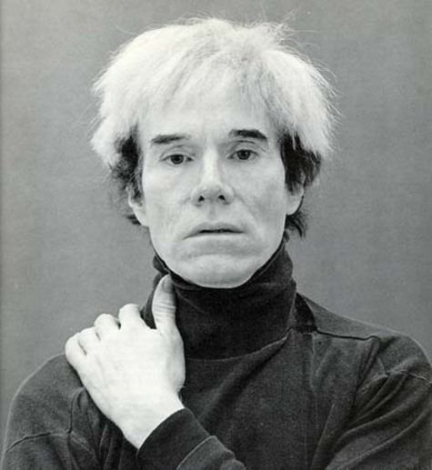
Background
Name at birth: Andrew Warhola
Born: August 6 1928
Pittsburgh, Pennsylvania
Died: February 22 1987 (complications from gallbladder surgery)
Best Known as: The pop artist who painted a Campbell's Soup can

Slide 3
Pop Art
Art movement from 1958 - 1975
post-war work centered on consumerism and materialism
an attempt to bring art back into American daily life, it rejected abstract painting because of its sophisticated and elite nature
shattered the divide between the commercial arts and the fine arts

Slide 4
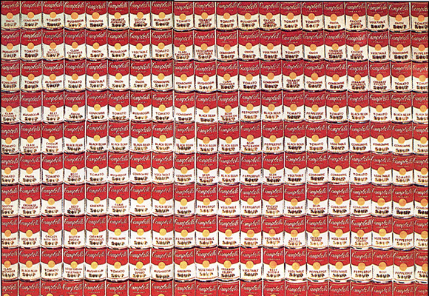
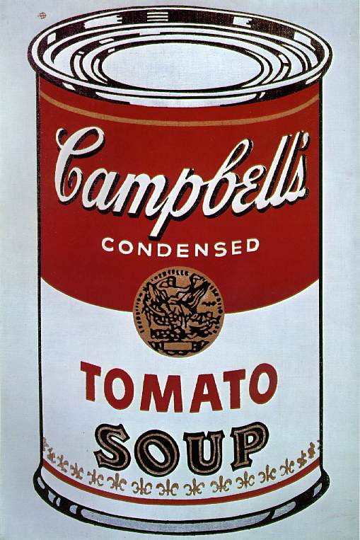
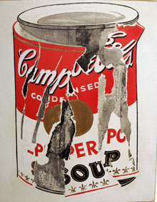
Warhol Pop Art
Warhol Design
Commercial Design

Slide 5
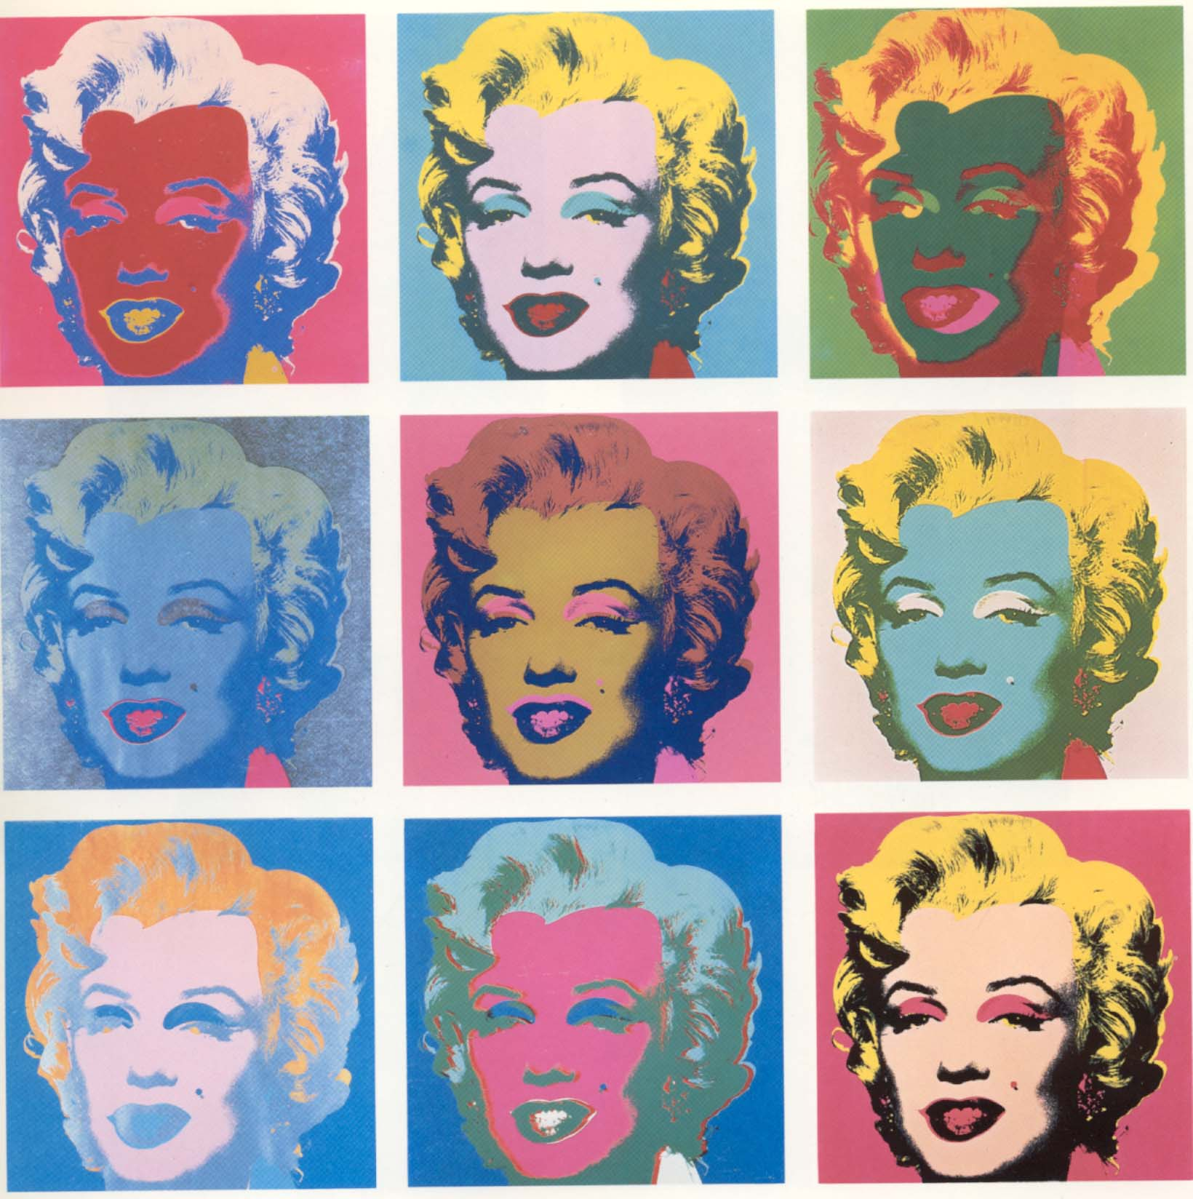
What’s the Mood?

Slide 6
He do/ We do

Slide 8
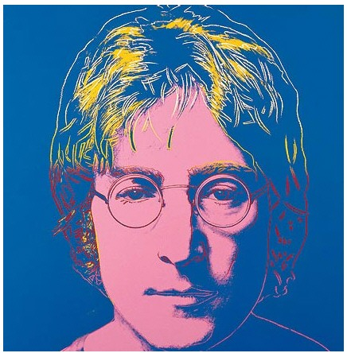
Warhol Critiques - Page 1

Slide 9
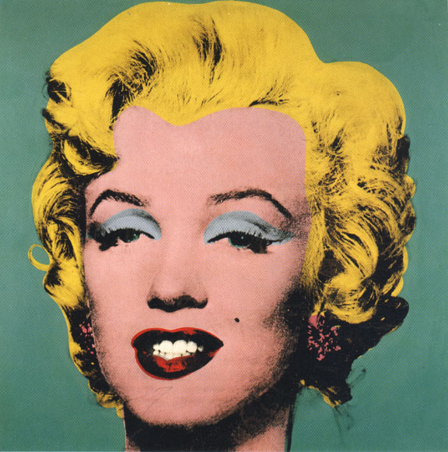
Page 2

Slide 10
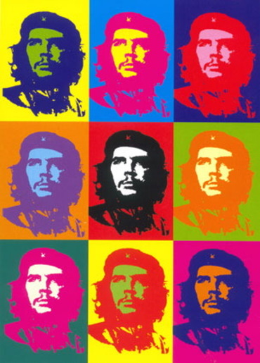
Page 3

