Slide 1
CLASS Camera Modes and Functions

Slide 2
Types of Class Cameras
SONY Cyber-shot

Slide 3
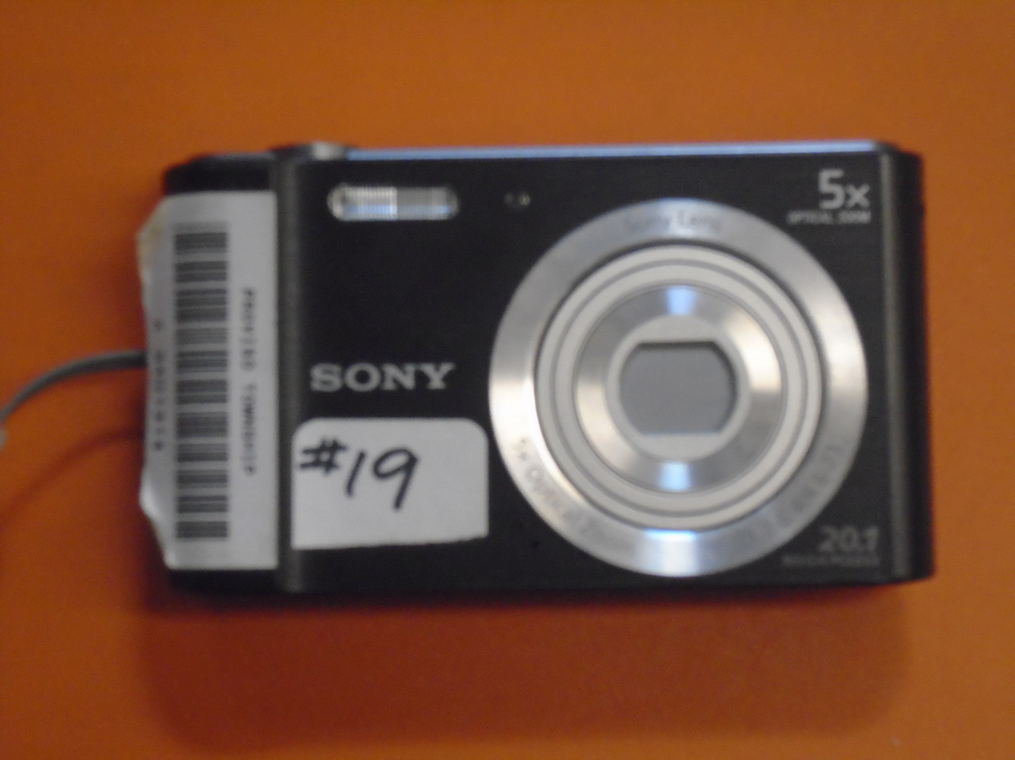
SONY (Cyber-shot)
Shutter Button
Flash
Lens(5-25 MM)
20.1 Megapixels

Slide 4
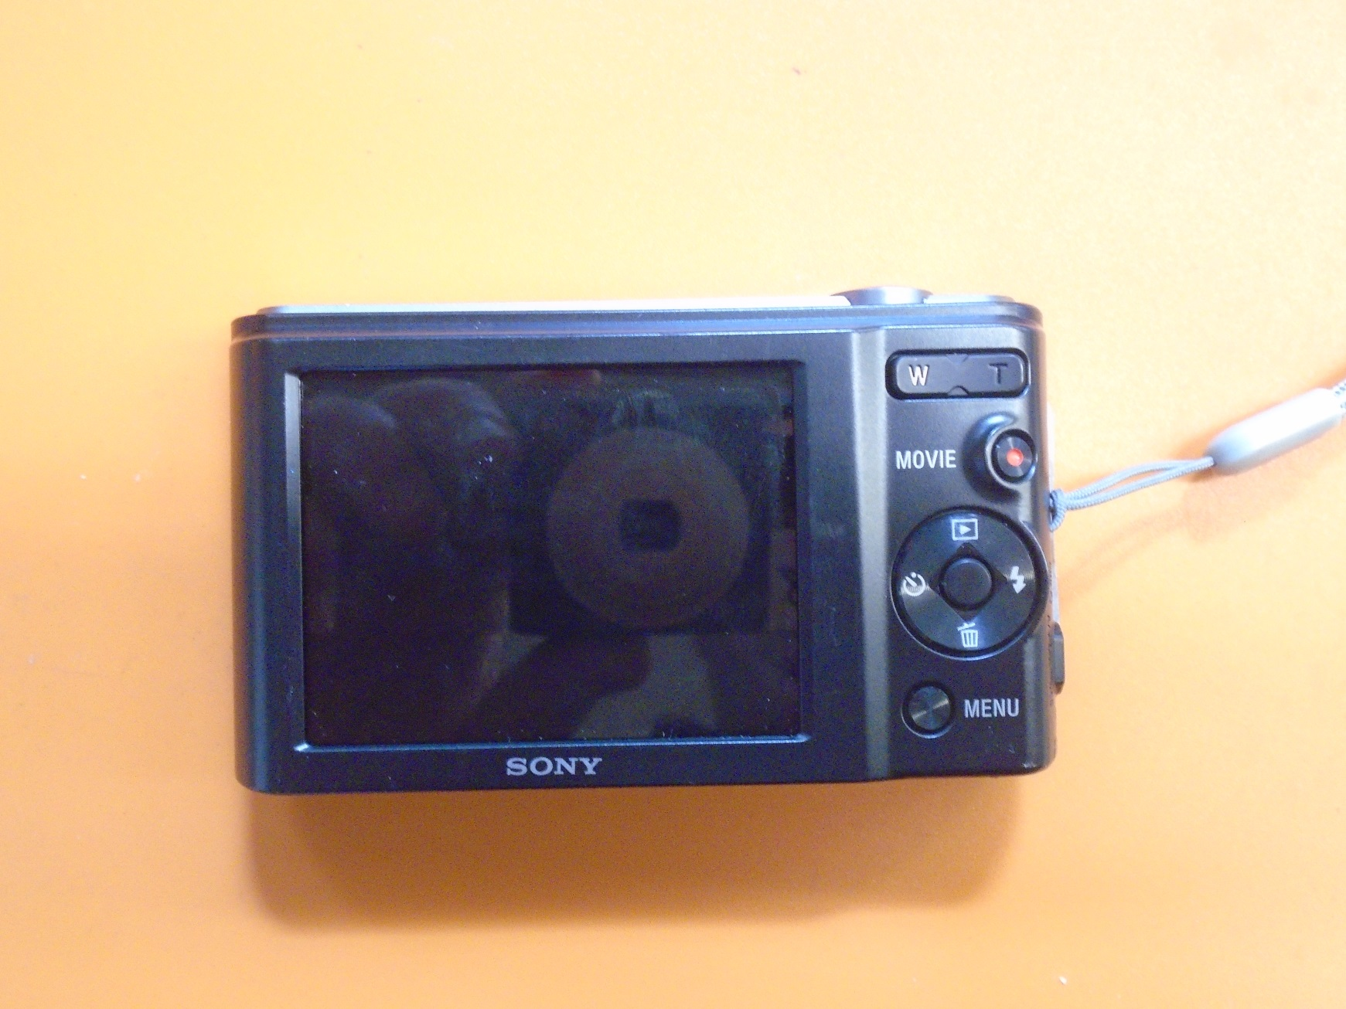
SONY (Cyber-shot)
Playback
Zoom control
View screen
Timer
Delete button
Menu: camera modes
Flash setting

Slide 5
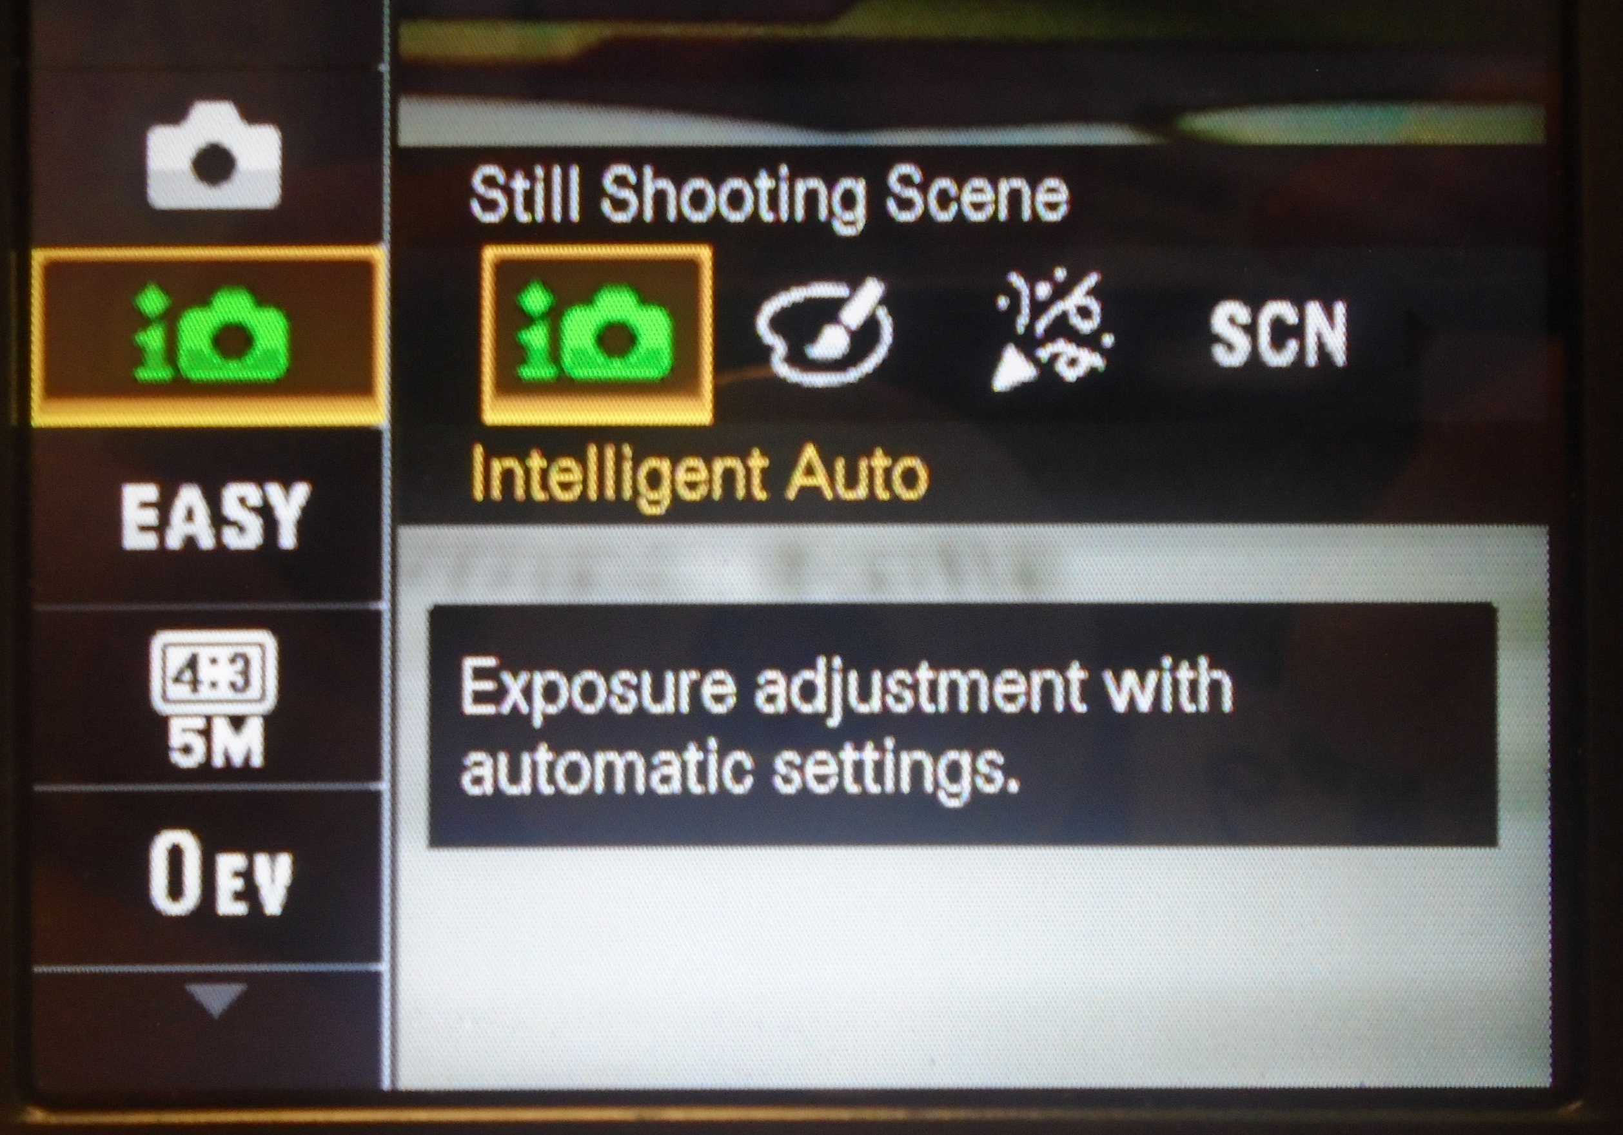
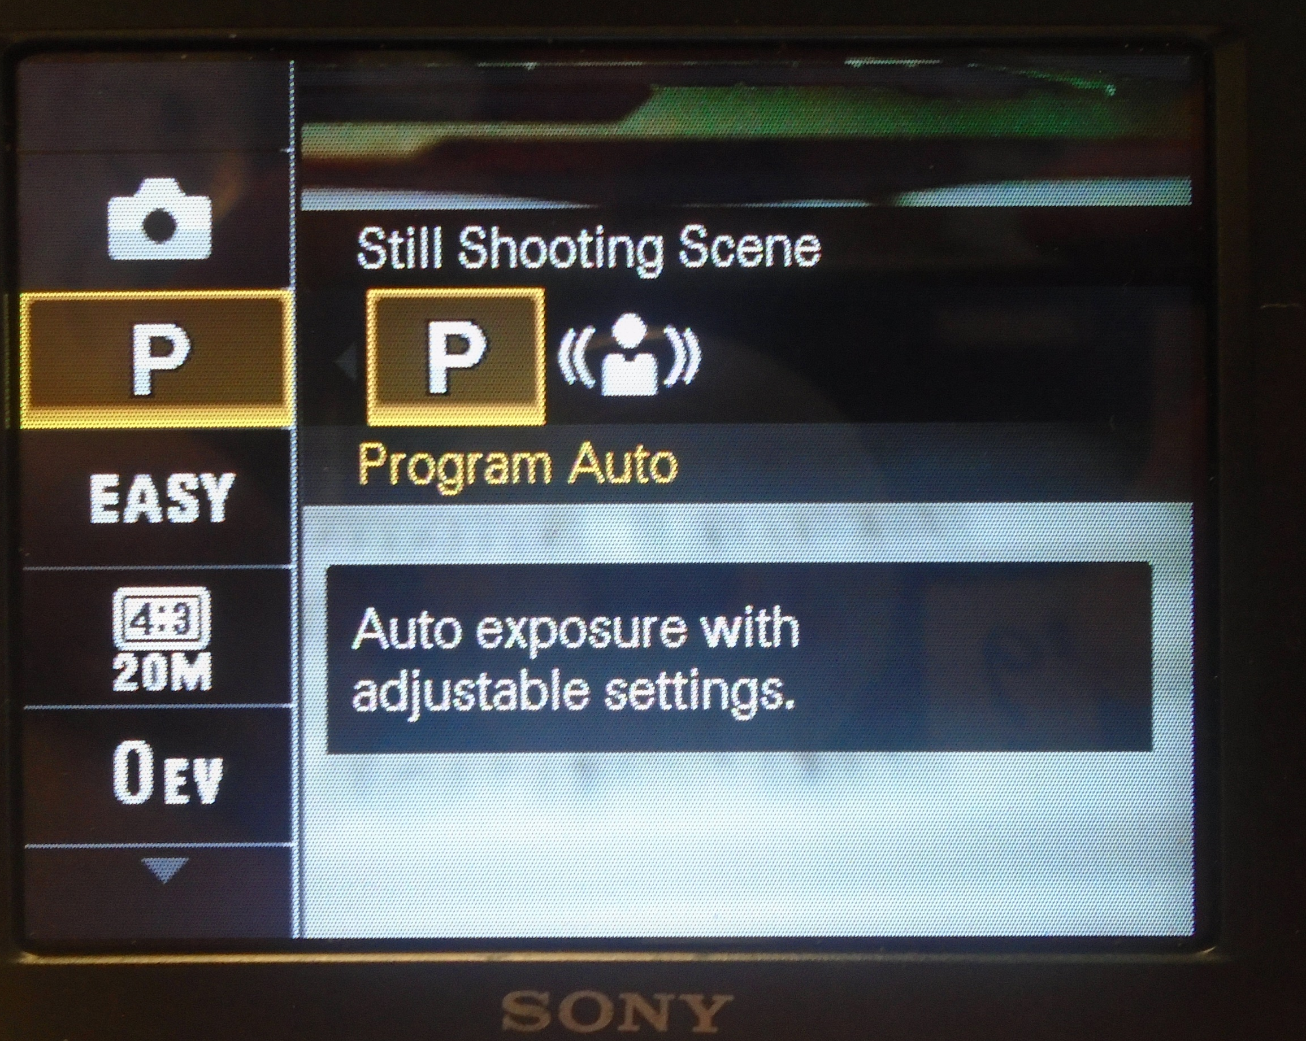
Changing Modes
Press MENU button
Use round control pad to move down to Itelligent Auto symbol
Use the round control pad to move to other Modes:
P = Program Auto
SCN = Scene

Slide 6
Changing Modes
Use the round control pad to move to other Modes:
SCN = Scene
Use the round control pad to select different Scene Modes
= Portrait
=Landscape
= ISO/High Sensitivity

Slide 7
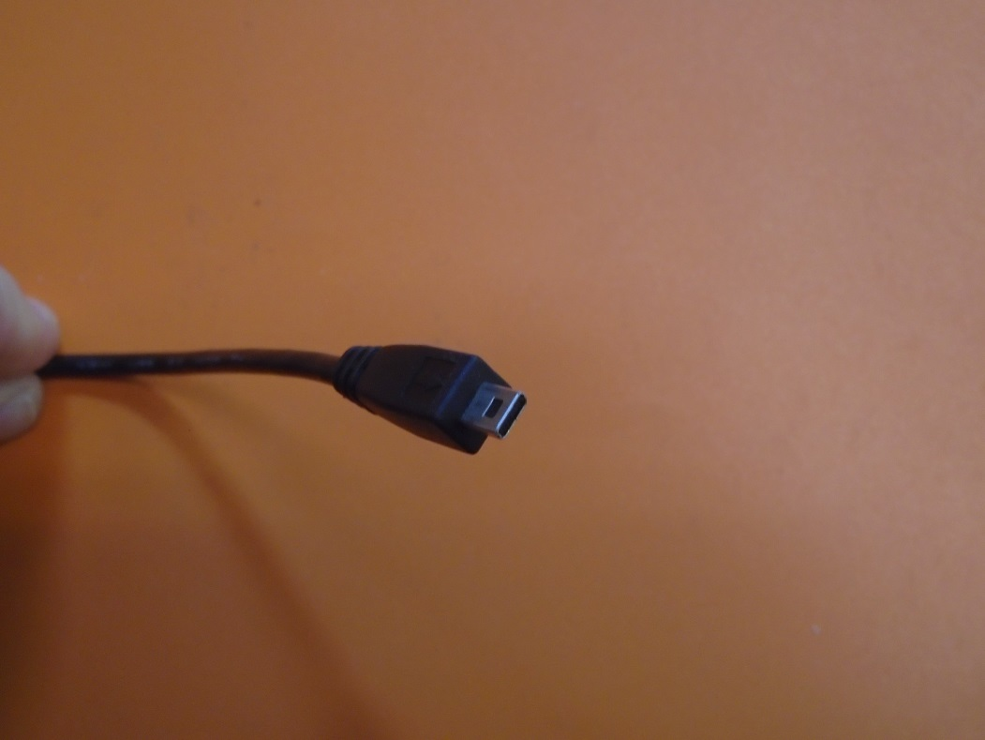
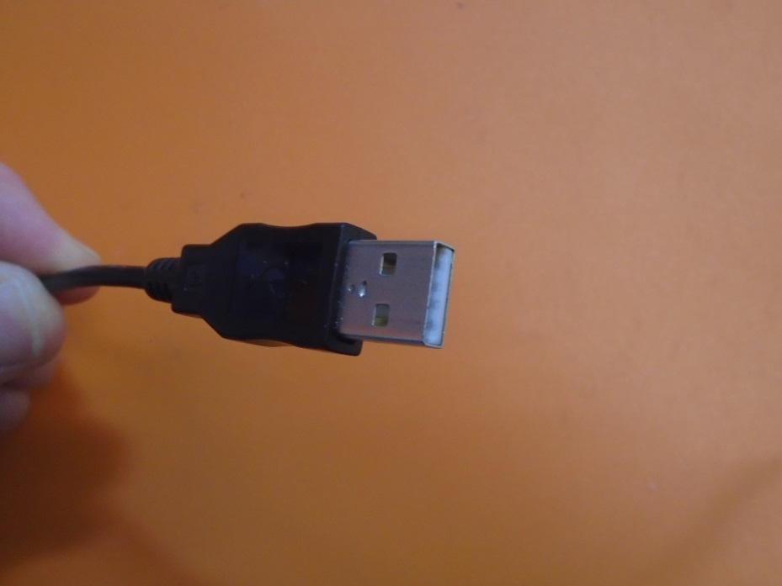
Connecting to Computer
SONY (Cyber-shot)
Black camera – black cord
Computer connection
Camera connection

Slide 8
Zoom Lenses
Optical zoom
SONY Cyber-shot is 5X
Good quality zoom setting, uses the lens!
Digital Zoom
SONY Cyber-shot has NONE
Poor quality zoom setting, alters the image digitally!

Slide 9
Settings and Modes

Slide 10
Automatic Modes
Auto- fully automatic, point-and-shoot mode; camera selects all settings. ALL CAMERAS
Program - camera automatically sets the shutterspeed and aperture based on the brightness of the scene. User can adjust some settings such as exposure compensation, white balance, ISO, focusing and metering modes. ALL CAMERAS
Auto Focus - camera selects depth of field and subject of focus. ALL CAMERAS
i
P
AF

Slide 11
Class Camera Modes
Portrait – photos of people during the day. Aperture is larger (less depth of field, blurry background), “ISO” is slower for less fine detail, shutterspeed is variable, but quicker to avoid capturing movement. Flash used when necessary. Focus is 3-10 ft in front of you. (ALL CAMERAS)
Night Portrait - take photos of a subject against a night scene. Aperture, focus and “ISO” are same as portrait but shutterspeeds are low - Use of tripod recommended. The built-in flash and red-eye reduction are enabled. (ALL CAMERAS)
Landscape - take photos of wide scenes. Aperture is small to pick up detail, shutterspeed is vairable, “ISO” is fast for detail. No flash. Focuses on a distant object 10 - ∞ ft. (NIKON ONLY)
Night Scene - photograph nightscapes. Same as Landscape but with slow shutterspeeds. Use of tripod recommended. Focus is 10 - ∞ (NOT SONY)
Macro (Close-Up) - take close-up shots of small objects, flowers and insects. Aperture small for detail, shutterspeed is fast, and “ISO” is fast. Focus is 0-3 ft. Hold the camera steady or use a tripod. (SONY in Intelligent Auto)
Sports- take photos of a fast moving subject. Aperture is smaller (more depth of field), fast shutter speeds to “freeze” the action and fast “ISO” to capture more light. Best when taking photos bright light; pre-focusing recommended. Focus is 3-10 ft. (SONY in Intelligent Auto)
Slow/Long Shutterspeed –intentionally blur moving objects. Aperture small for deetail, shutterspeed is slowed to blur movement and “ISO” is slowere for less detail. Focus is 3-10 ft. (NOT on SONY)

Slide 12
Auto Special Lighting Modes
Beach/Snow - photograph beach, snow and sunlit water scenes. Exposure and white balance are set to help prevent the scene from becoming washed out looking. (ALL CAMERAS)
Fireworks - shutter speed and exposure are set for shooting fireworks; pre-focusing & use of tripod recommended. (ALL CAMERAS)
Party - take photos in a dim lit room; aperture and shutter speed are automatically adjusted for room brightness. Captures indoor background lighting or candlelight. Hold the camera very steady when using this mode. (ALL CAMERAS)
Sunset - take photos of sunsets and sunrises; helps keep the deep hues in the scene. (ALL CAMERAS)
.
Backlight - eliminates dark shadows when light is coming from behind a subject, or when the subject is in the shade. The built-in flash automatically fires to “fill in” the shadows. (NIKON ONLY)

Slide 13
Timer Modes
Self Timer
used is to take photos of a group or scene, or when you want to take a self-portrait.
The camera must be set on a tripod or level surface
taking close-up shots.
taking photos in low light without a flash or shooting long exposures.

Slide 14
Flash Modes
A
Automatic mode — Flash triggers automatically when the camera determines more light is needed in a scene. Turn off this mode in places that forbid inside flash photography such as museums. (ALL CAMERAS)
Suppressed flash — Turns the flash off. (ALL CAMERAS)

